Slide 1



Hello!
I AM MARIANGEL RAMIREZ
You can find me at:
www.linkedin.com/in/mariangel-ramirez/
mariangelrmrz@gmail.com
Notes:
Hi. As the screen says my name is Mariangel and I am here to talk about my experience during the mentorship.
For my project, I wanted to make a Virtual Reality game to help my friends learn some bartending skills and also allow me to practice on making drinks without spending any money on alcohol, wasting alcohol or making a mess that I would have to clean up after. But before I go on about what I learned during the mentorship let me go over what VR is really quick.

Slide 2
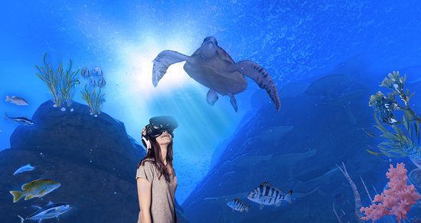
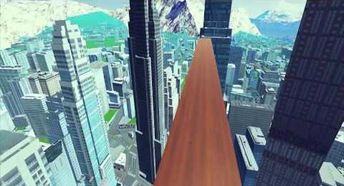
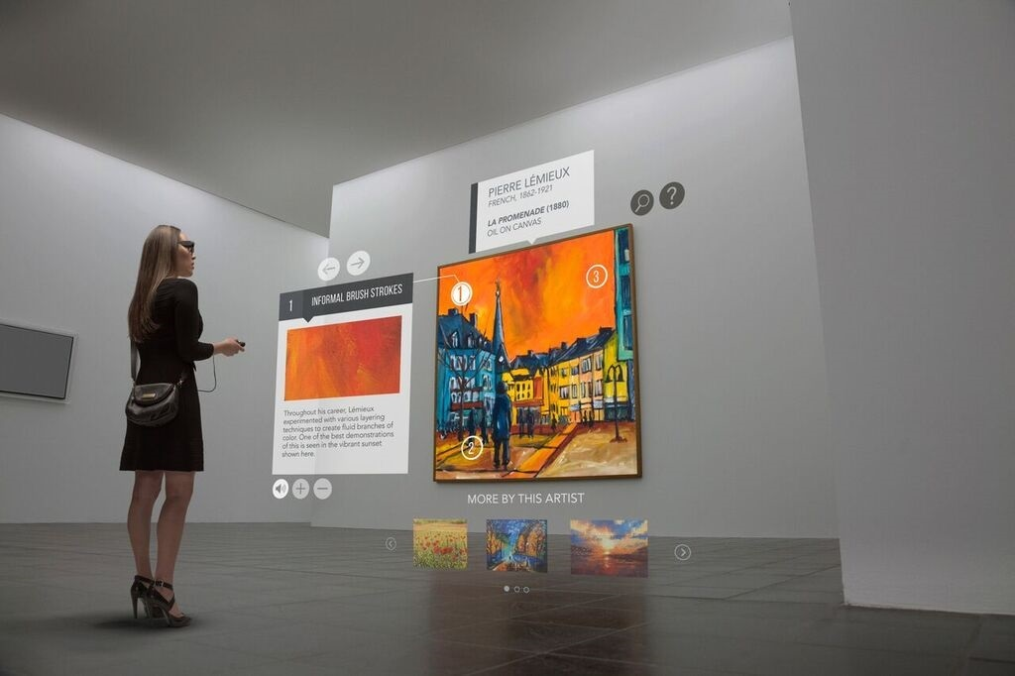
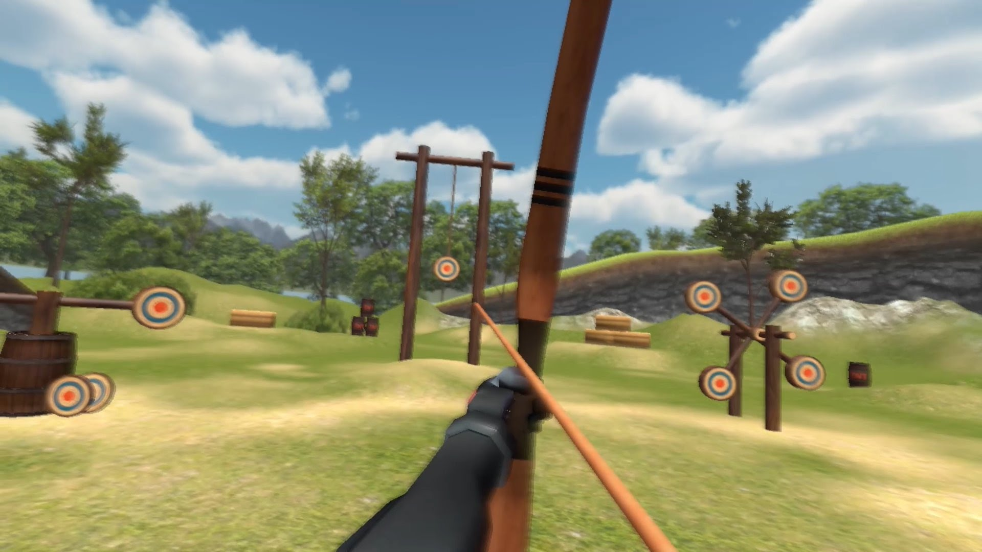

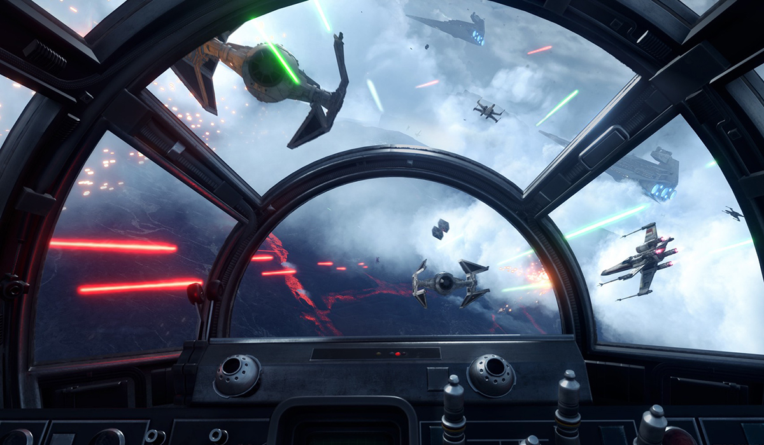
WHAT IS VR?
Notes:
Who here knows what VR is or has used VR headsets before? (wait for people to raise hands) Alright, for those who don’t know anything about VR, it is a technology used with a headset to immerse yourself into a virtual world. The possibilities for virtual worlds are endless, you can be standing on a wooden plank at the top of a skyscraper, an archery range in the middle of the woods, fighting the Empire like a star wars movie, a museum in France without having to travel there. The list goes on..

Slide 3
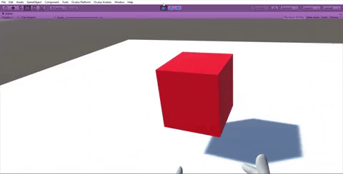
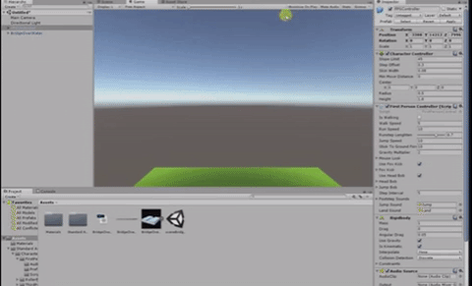
WORKING WITH UNITY
Notes:
In order to make a VR game you need to use special software like Unity and if I had to describe Unity in a few words it would be “an extremely needy person”. To do something simple like grabbing a cube you can’t just add a cube to your scene and expect it to work. You need to add physics to it and other components, also a floor for you to stand on (which also needs proper physics) and a lot of the time you need to code certain behaviors too or else things don’t work properly like this (click) or this (click) see what I mean? It’s so needy.

Slide 4
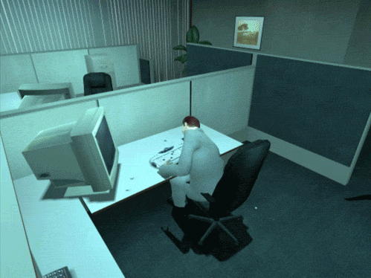

BIGGEST LESSON
Patience
Notes:
I could go on about all the little things that are required to make a proper VR game but I gotta keep this short so let’s move on to my biggest lesson which is being patient. A lot of the time I would be like this and get stuck on something for HOURS. I would google how to fix it but found nothing so I would just stare at the screen as if things would magically get fixed on their own (click) or I would get mad and want to give up on everything. Of course, I would ask my mentor for help but I had to struggle for a while and learn my lesson alright?

Slide 5

RESULT
Notes:
After many hours of struggle, here’s a little video of what my game can do.
(hands video) Because I chose the Oculus rift, which has a fancy controller, I can do a lot of cool hand movements that weren’t just grabbing and letting go. I didn’t need them my game but it’s just fun to do.
(start screen) When you start the game, there will be a menu screen so you just play through all the levels in the game or practice on your own. each level will be in a different room but I am mostly going to focus on what I like to call “practice mode” which is a basic room with a bunch of liquor bottles and glasses. There won’t be any customers or penalties or time limits. It’s just you and a bar. You can teleport to “walk” around, pick up bottles, pour liquids into glasses without ever running out of alcohol, throw things, make a mess. The point of this room is to just have fun.

Slide 6
Thank you!
ANY QUESTIONS?
You can find me at:
www.linkedin.com/in/mariangel-ramirez/
mariangelrmrz@gmail.com
Notes:
Before I end, I want to give a big thank you to my mentor ROY and also chic geek for having the mentorship program and thank you guys so much for listening.

